Slide 1
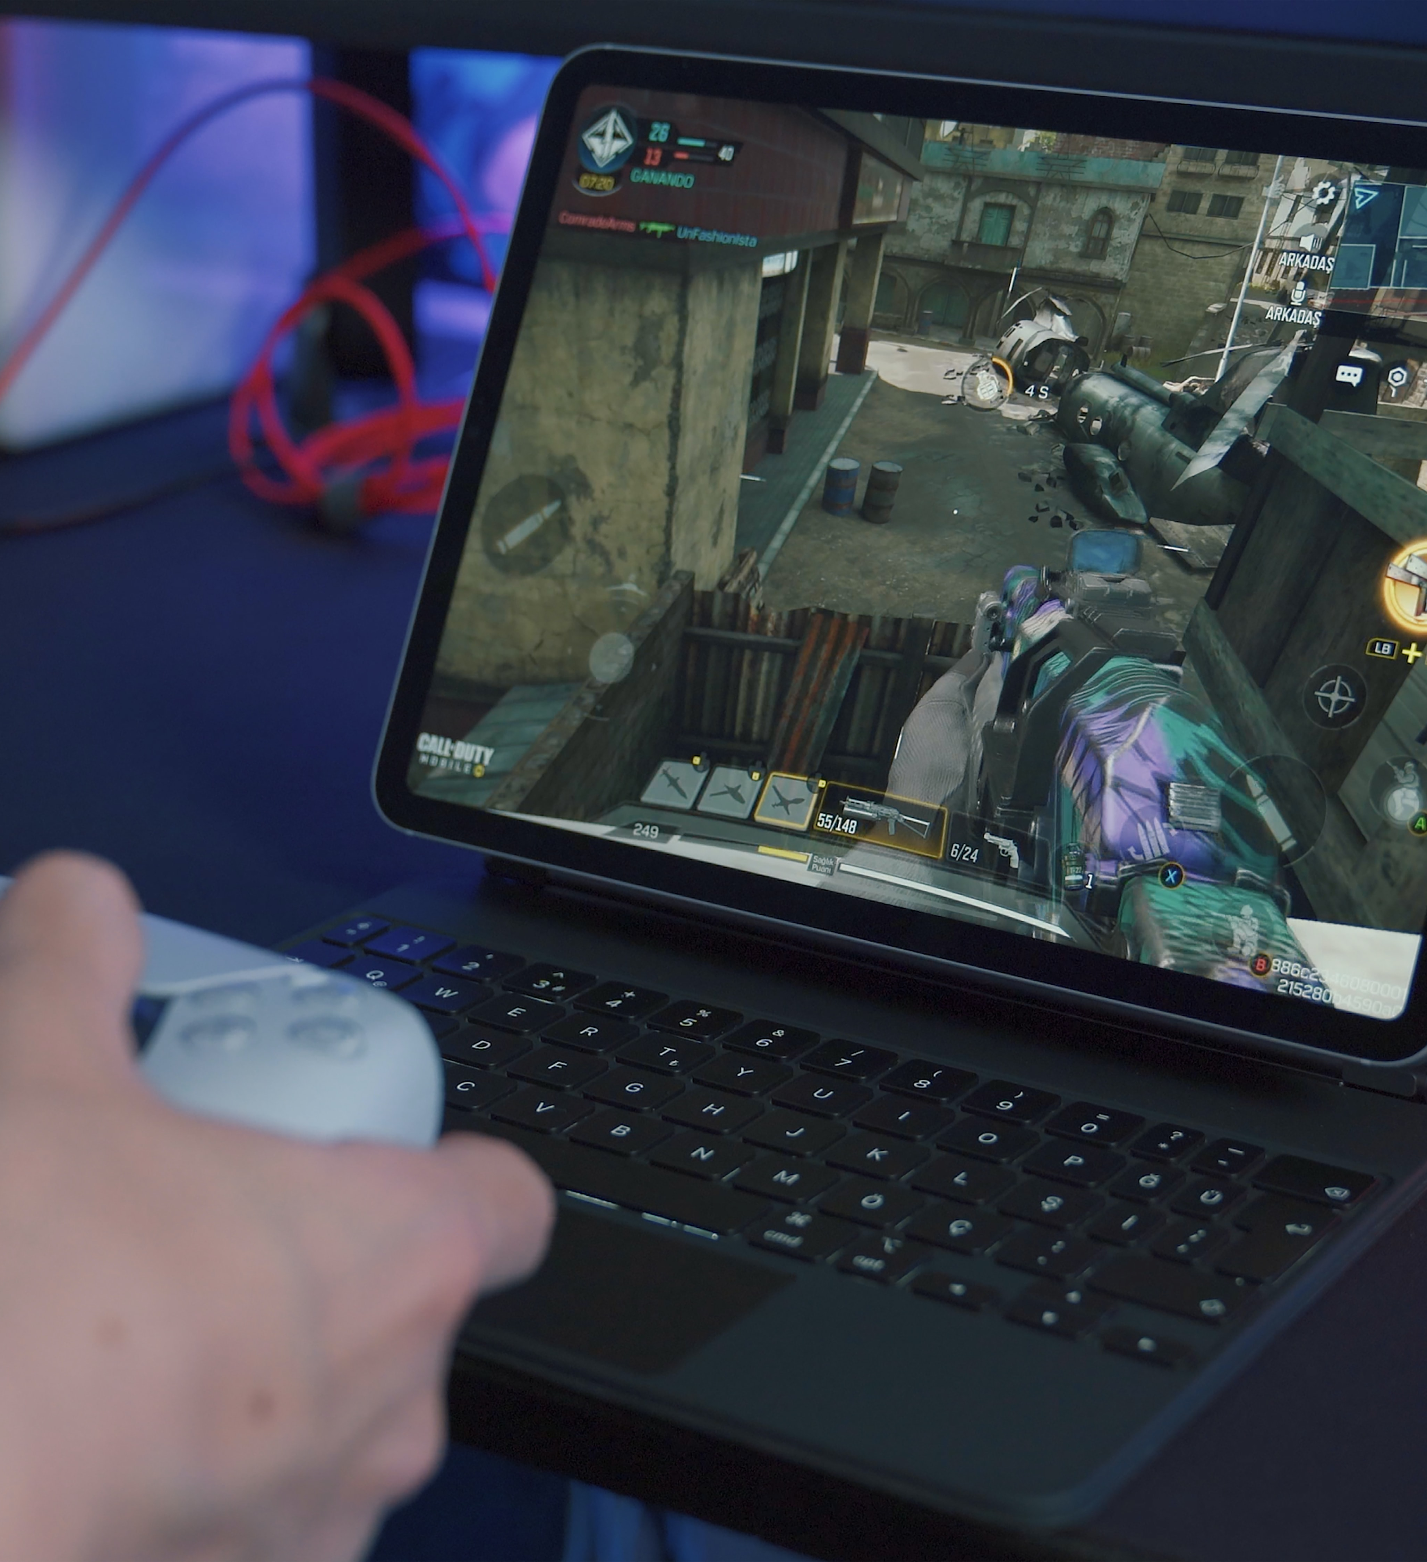
Gaming Arena
22PMC131

Slide 2

ABSTARCT
Django-based web application for online gaming events.
Aims to connect gamers and facilitate competitions.
Provides user registration, authentication, and profile management.
Supports various gaming events and tournaments.
Allows users to browse, book slots, and make payments.
Enables users to upload and view gaming event results.
Focuses on creating a thriving online gaming community.
Notes:
gettyimages-1061332616-2048x2048

Slide 3
REQUIREMENTS
User
Registration process and requirements
View upcoming events and their details
Book slots for events
Event status updated automatically to "closed" after event ending time
Payment
Event winners to update their information
View and update profile information
View event history and winnings
Admin
View bookings and update event status
Create and manage events

Slide 4
FEATURES AND HIGHLIGHTS
▪Game Listing: The system displays a list of available games for users to choose from.
Admin Panel: An administrative panel allows the platform administrators to manage games, events, and user bookings.
Slot Availability: Users can view the available slots for each game.
Event Results: Users can upload results for completed gaming events.
User Profiles: Users have personalized profiles where they can view and edit their information.

Slide 5
TECHNICAL ASPECTS
▪Django Framework: Django is the primary framework used for building the project. It provides a robust foundation for developing web applications, offering features such as URL routing, database connectivity, authentication, and templating.
▪Python: Theproject is written in Python, a versatile and powerful programming language known for its simplicity and readability. Python is used to implement the backend logic, handle data processing, and perform various system-level operations.
▪HTML/CSS/JavaScript: The project utilizes front-end technologies such as HTML, CSS, and JavaScript to develop the user interface and enhance user interactions. These technologies are essential for creating responsive and visually appealing web pages.
▪Database Management System (DBMS): The project utilizes a DBMS to store and manage data related to users,, game, view profile, booking. DBMS in Django project include SQLite.

Slide 6
THIRD-PARTY LIBRARIES
Bootstrap: Bootstrap is a popular CSS framework used for responsive web design and UI components, making it easier to create visually appealing and mobile-friendly interfaces.
Pillow: A powerful library for image processing and manipulation.
Jazzmin: This package is used for admin panel customization in django.

Slide 7
ARCHITECTURE
Models: The models define the data structures and relationships within the project, including entities such as Events, User, Game, Arena, Slot, Booking.
Views/View Models: They handle user requests, retrieve data from the database, and prepare the data for rendering in the templates.
Templates: Templates contain the HTML/CSS structure and presentation logic for rendering the user interface. They are responsible for displaying the data fetched from the views and rendering it in a user-friendly format.
Routers: Routers handle the URL routing and map the incoming requests to the appropriate views or view models. They define the endpoints and HTTP methods for handling user requests.

Slide 8
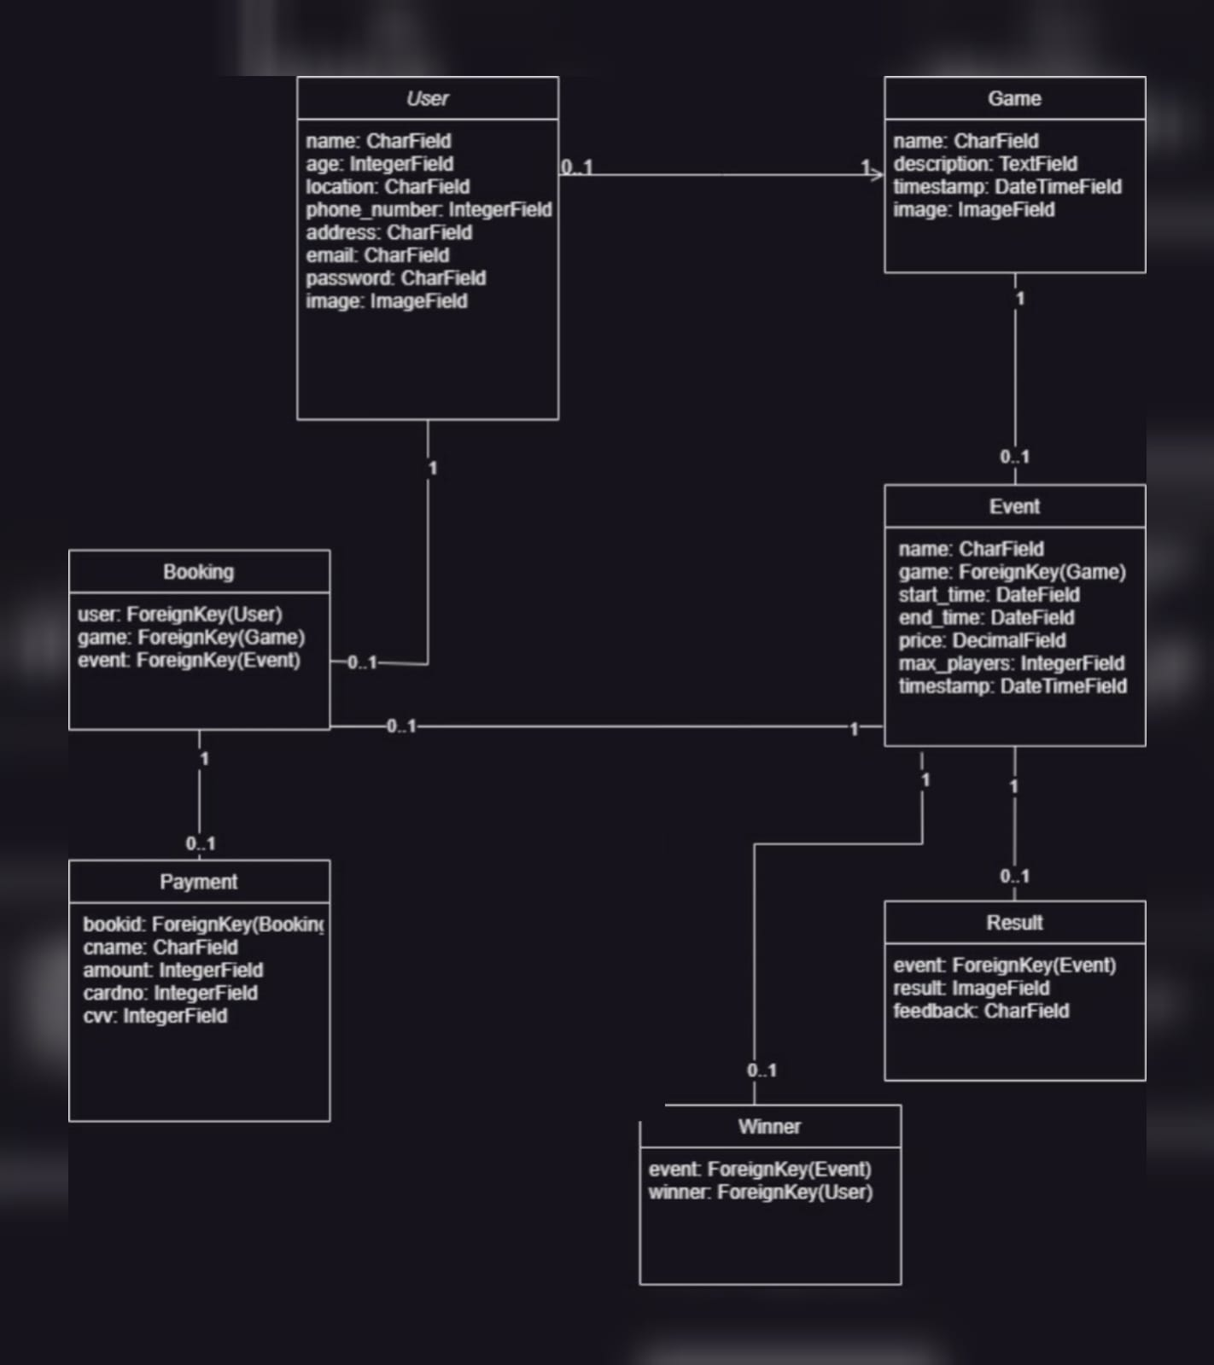
CLASS DIAGRAM

Slide 9
CHALLENGES FACED
User Experience and UI Design: Creating an intuitive and user-friendly interface that provides an immersive gaming experience requires careful UI/UX design. Balancing functionality, responsiveness, and visual appeal while considering user feedback and preferences can be a challenge.
Testing and Debugging: Ensuring the quality and reliability of the project require thorough testing and debugging. Identifying and fixing issues, handling edge cases, and writing comprehensive test cases can be time-consuming and challenging.

Slide 10
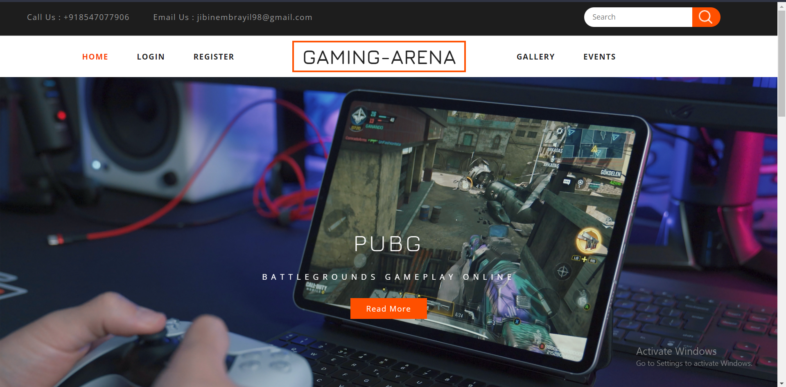
SCREENSHOTS

Slide 11
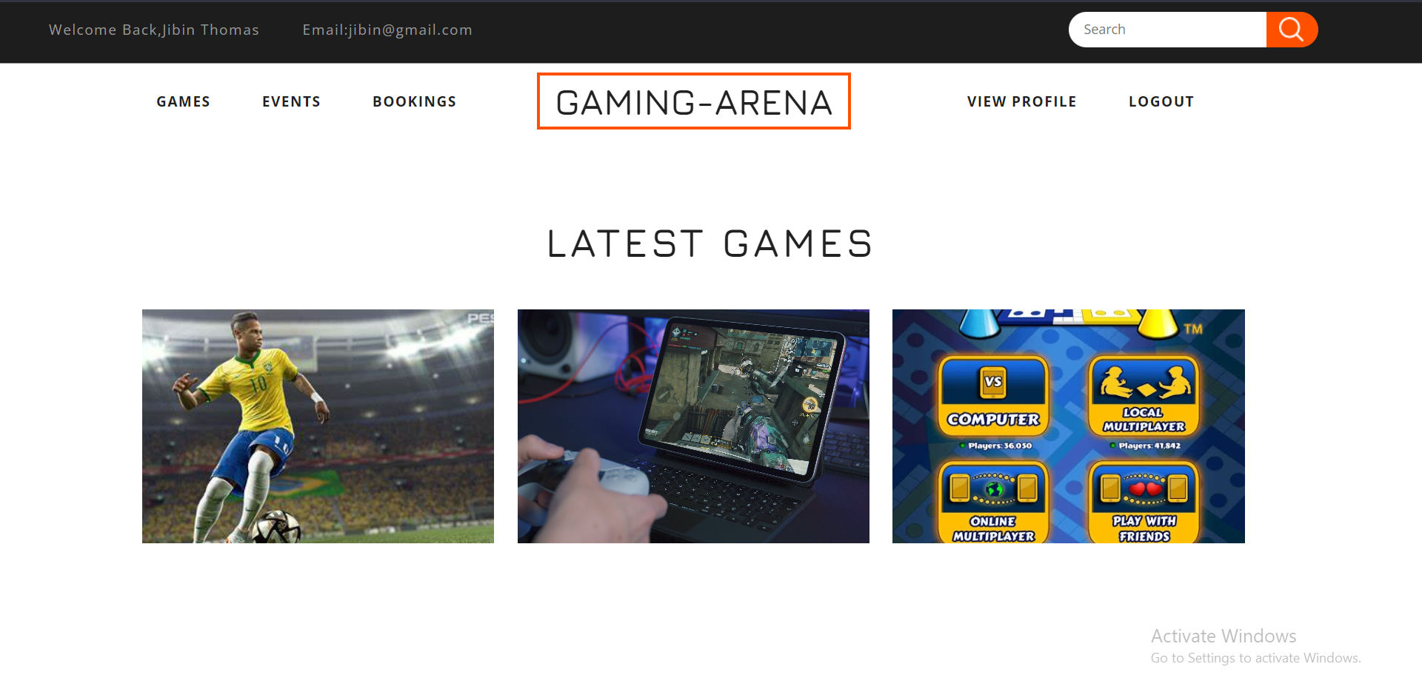
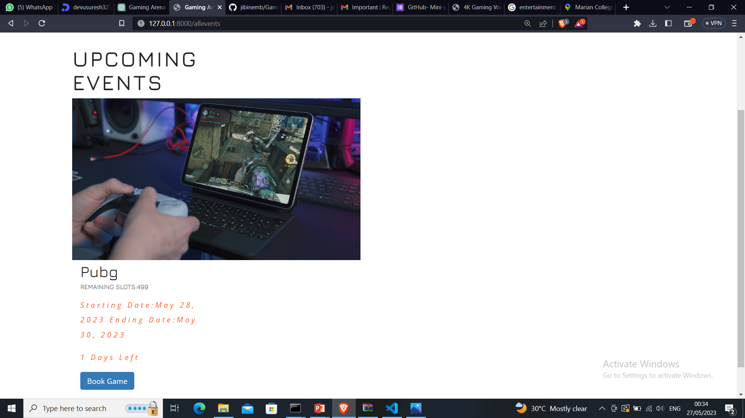
SCREENSHOTS
Games
Events

Slide 12
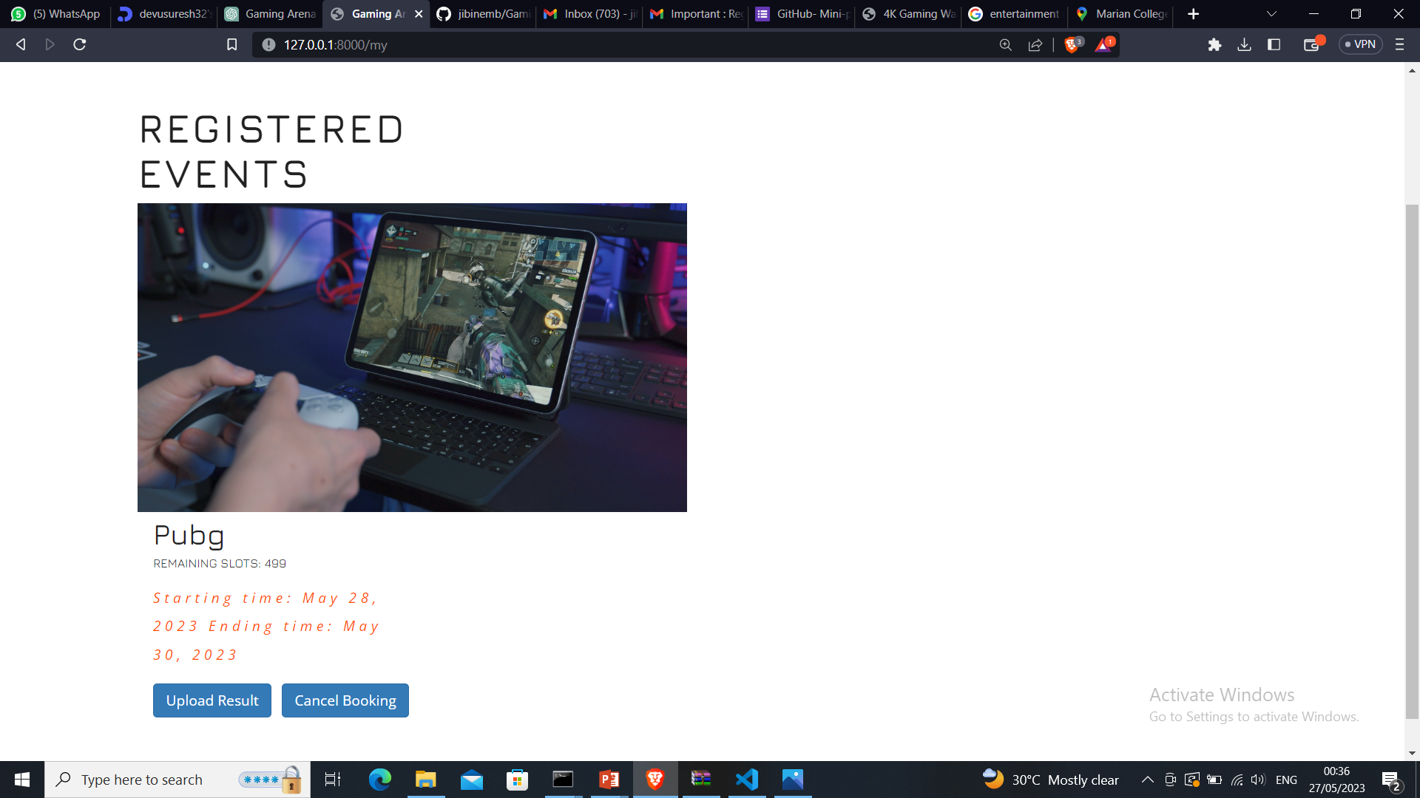
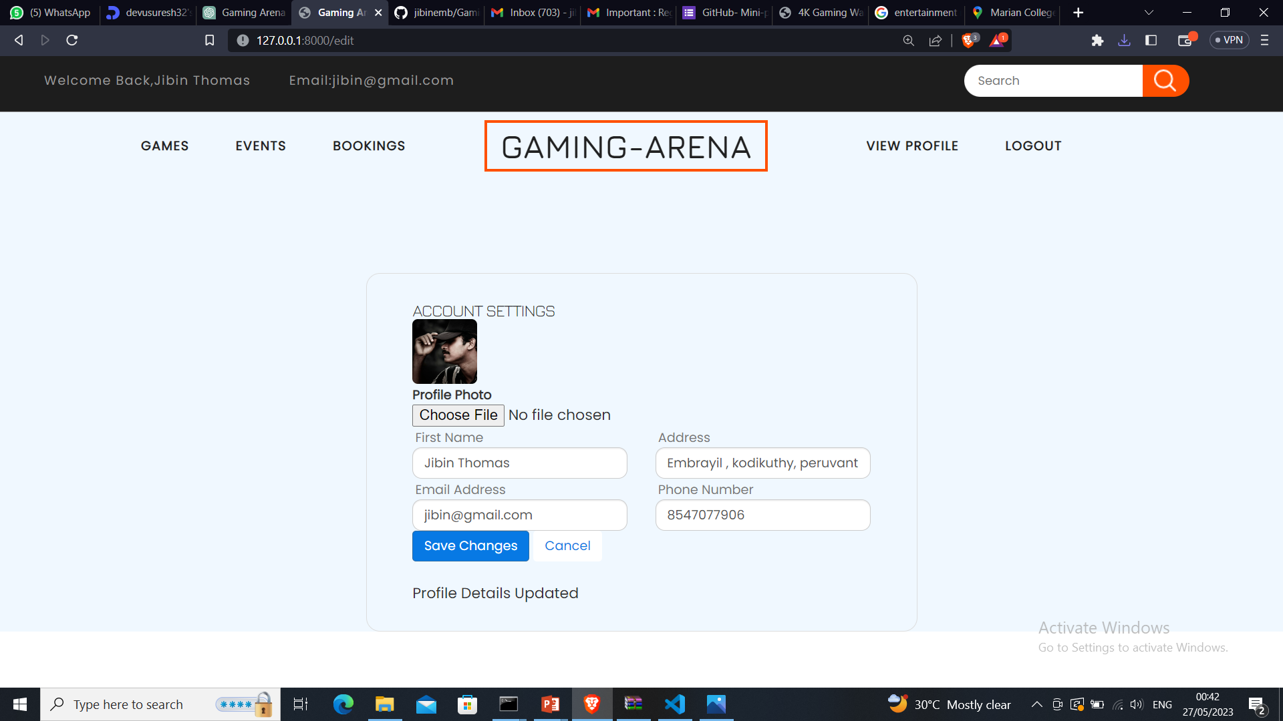
SCREENSHOTS
bookings
Edit profile

Slide 13
FUTURE ENHANCEMENTS
Enhanced Social Features: Expand social interaction capabilities by incorporating features like friend lists, followers, and user-generated content. Users can connect with friends, create gaming communities, share content, and engage in social activities within the platform.
Tournament Management: Introduce comprehensive tournament management functionality, allowing users to create and manage their own tournaments. This includes features like automated bracket generation, match scheduling, and prize distribution.
Integration with Streaming Platforms: Integrate with popular game streaming platforms like Twitch or YouTube Gaming, allowing users to live stream their gameplay or watch live streams within the gaming arena platform. This enhances the community aspect and offers additional entertainment value.

Slide 14
CONCLUSION
The gaming arena project developed in Django Python offers a comprehensive platform for gamers to participate in events, connect with fellow players, and showcase their gaming skills. With features such as event creation, user registration, team management, match scheduling, and result tracking, the project provides a dynamic and engaging environment for the gaming community. Technical aspects such as the Django framework, third-party libraries, and database management contribute to the project's functionality, security, and scalability. The architecture of the project follows a layered approach, separating concerns and ensuring a modular structure. While developing the project, various challenges may arise, including designing the data model, ensuring user authentication and security, handling concurrent user interactions, optimizing performance, and integrating with external APIs. However, with careful planning, expertise, and collaboration, these challenges can be overcome. As for future enhancements, integrating real-time communication, enhancing social features, advanced matchmaking, tournament management, and exploring mobile application development can further enhance the user experience. In conclusion, the gaming arena project in Django Python serves as a robust and engaging platform for gamers, offering opportunities for participation, competition, and social interaction within the gaming community. Continual improvement and innovation can ensure the project's growth and success in the dynamic world of gaming.

Slide 15
References
https://youtu.be/OTmQOjsl0eg
https://www.youtube.com/watch?v=xSUm6iMtREA
https://www.youtube.com/watch?v=1UvTNMH7zDo

Slide 16

Thank you

